Slide 1
ENERGY AUDIT INSTRUMENT
Asst.Prof. krunal khiraiya
Mechanical engineering department
Parul institute of engineering and technology
Limda, Baroda

Slide 2
Why instrument are required in energy audit?
Identification and qualification of necessitates measurement
Portable, easy to operate and relatively inexpensive

Slide 3
Parameters monitor during energy audit
Electric :
Voltage, current ,power factor, energy consumption
Other than electric:
Temp. Pressure , heat flow, radiation, air and gas flow, rpm, vibration, TDS, Ph, moisture content, flue gas analyzer

Slide 4
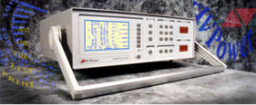
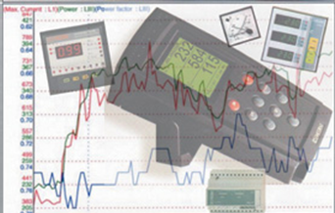
These are instruments for measuring major electrical parameters such as kVA, kW, PF, Hertz, kVAr, Amps and Volts. In addition some of these instruments also measure harmonics.
Electrical Measuring Instruments:

Slide 5
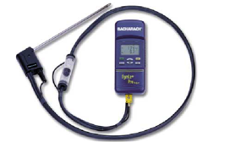
Flue Gas analyzer
This instrument has in-built chemical cells which measure various gases such as O2, CO, NOX and SOX.

Slide 6
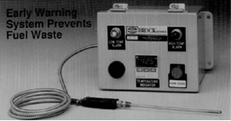
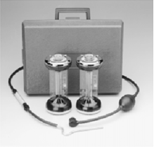
Fuel Efficiency Monitor: This measures oxygen and temperature of the flue gas. Calorific values of common fuels are fed into the microprocessor which calculates the combustion efficiency.
Fyrite:
A hand bellow pump draws the flue gas sample into the solution inside the fyrite. A chemical reaction changes the liquid volume revealing the amount of gas. A separate fyrite can be used for O2 and CO2 measurement.

Slide 7
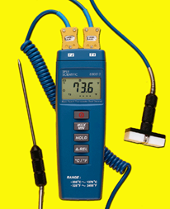
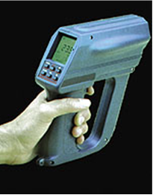
Contact thermometer: These are thermocouples which measures for example flue gas, hot air, hot water temperatures by insertion of probe into the stream. For surface temperature, a leaf type probe is used with the same instrument.
Infrared Thermometer:
This is a non-contact type measurement which when directed at a heat source directly gives the temperature read out. This instrument is useful for measuring hot spots in furnaces, surface temperatures etc.

Slide 8
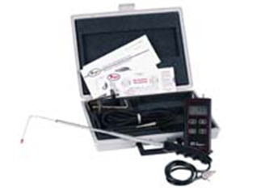
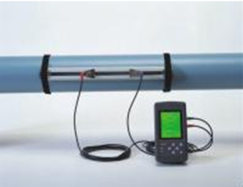
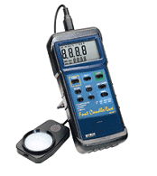
Pitot Tube and manometer: Air velocity in ducts can be measured using a pitot tube and inclined manometer for further calculation of flows.
Water flow meter:
This non-contact flow measuring device using Doppler effect / Ultra sonic principle. There is a transmitter and receiver which are positioned on opposite sides of the pipe. The meter directly gives the flow. Water and other fluid flows can be easily measured with this meter.
Lux meters:
Illumination levels are measured with a lux meter. It consists of a photo cell which senses the light output, converts to electrical impulses which are calibrated as lux.

Slide 9
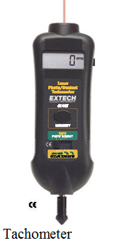
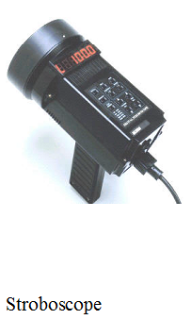
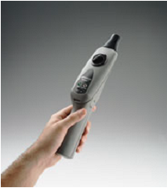
Speed Measurements: In any audit exercise speed measurements are critical as they may change with frequency, belt slip and loading. A simple tachometer is a contact type instrument which can be used where direct access is possible. More sophisticated and safer ones are non contact instruments such as stroboscopes.
Leak Detectors:
Ultrasonic instruments are available which can be used to detect leaks of compressed air and other gases which are normally not possible to detect with human abilities.

Slide 10
THANK YOU

