Slide 1
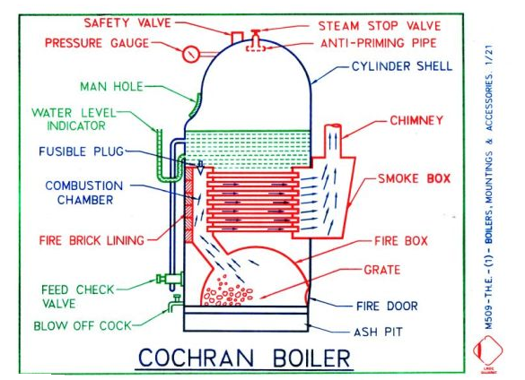

Slide 2
Cochran Boiler Specification:
Shell diameter : 2.75 m
Height : 5.75 m
Working pressure : 6.5 bar (Maximum 15 bar)
Steam capacity : 3500 kg/hr (Maximum 4000 kg/hr)
Heating surface area : 120 m²
Efficiency : 70% to 75%
Characteristics:
Vertical boiler
Fire tube boiler
Number of tubes are 160 to 165
Tube diameter is 60 to 62 mm
Internally fired
Natural circulation
Advantages:
Minimum floor area
Cost of construction is low
It can be moved and setup readily in different locations
It has self contained furnace
Disadvantages:
Steam raising capacity is less
Difficulty in cleaning and inspection
The capacity and pressure are limited
The boiler requires high head room

Slide 4
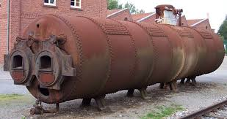
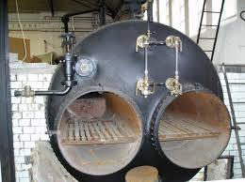

Slide 5
Lancashire Boiler Specification:
Shell diameter : 2 to 3 m (Most commonly used is 2.74 mm)
Height : 7 to 9 m
Working pressure : 16 bar
Steam capacity : 8000 - 9000 kg/hr
Heating surface area : 120 m²
Efficiency : 50% to 70%
Characteristics:
Horizontal boiler
Fire tube boiler
Stationary boiler
It has two fire tubes
Tube diameter is 150 to 200 mm
Medium pressure boiler

Slide 6
Lancashire Boiler Advantages:
Due to large reservoir capacity, the load fluctuations can be easily be met by this boiler.
Easy to clean and inspect
Heating surface area / unit volume of the boiler is considerably large
Maintenance costs are low
It is reliable
Operation is easy
Disadvantages:
Maximum pressure is limited to about 16 bar
More floor area is required due to brickwork settings
Due to large water capacity, for developing more pressures, boiler takes high time
Since the furnace is inside the tubes the grate area is restricted
Application:
Sugar mills, textile industries where steam is required for power generation as well as for the process work. It is also used in chemical industries.

Slide 8
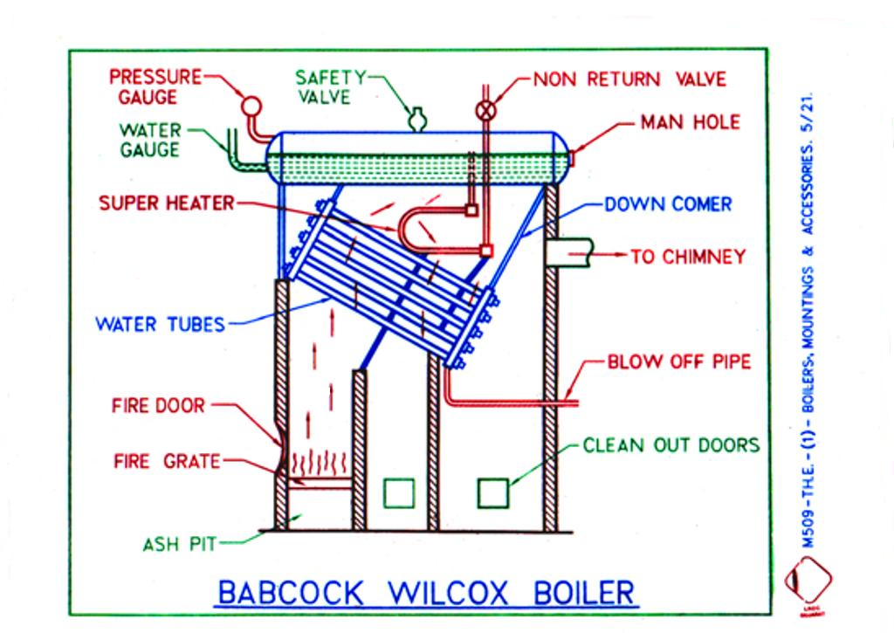

Slide 9
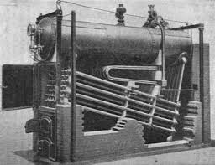

Slide 10
Babcock & Wilcox Boiler Specification:
Drum diameter: 2 to 4 m
Length : 6 to 9 m
Size of the water tubes : 38 to 57 mm
Size of the upper header tubes : 76 to 101 mm
Maximum working pressure : 42 bar
Steam capacity : 40000 kg/hr
Efficiency : 60% to 80%
Characteristics:
Horizontal boiler
Water tube boiler
Stationary boiler
Externally fired
Natural circulation of water
High pressure boiler
Advantages of Babcock & Wilcox Boiler :
Both solid and liquid fuel used
Evaporative capacity is high
Natural circulation of water
Defective tubes can be replaced easily
Used in power station of generating large quantity of steam
Steam capacity : 40000 kg/hr
Efficiency : 60% to 80%
Application:
Used in power station and where large quantity of steam is required

Slide 11
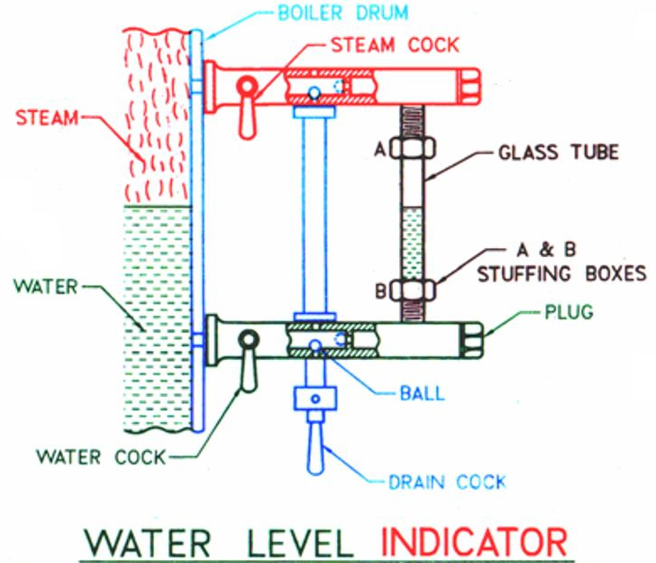
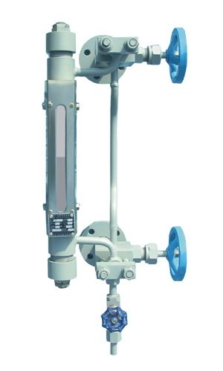
Construction:
it consists of three cocks and a glass tube.
Steam cock keeps the glass tube in connection with the steam space.
Water cock puts glass tube in connection with the water in the boiler.
Drain cock us used at frequent intervals to ascertain that the steam and water cocks are clear.
Function:
To indicate the level of water in the boiler constantly.
Location:
It is fitted at the front end of the boiler so that it is visible to the operator.

Slide 12
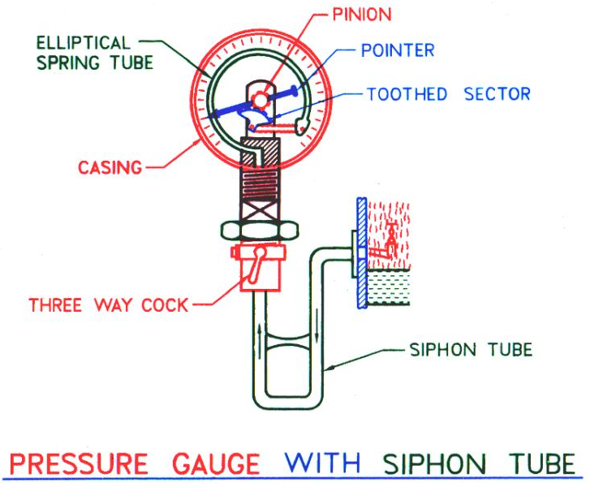
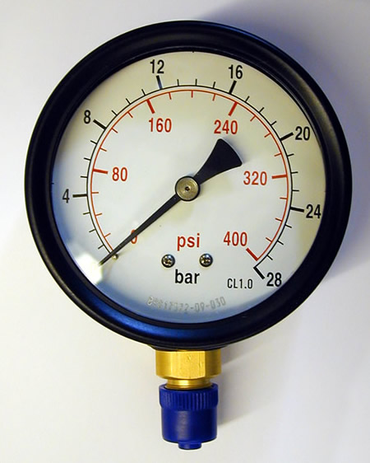
Construction:
The pressure gauge generally used are Bourden type.
It consists of an elliptical elastic tube bent into an arc of circle is called Bourden’s tube.
One end of the tube gauge is fixed and connected to the steam space in the boiler.
The other end is connected to a sector through link.
Function:
To indicate the pressure exerted inside the vessel.
Location:
It is fitted to the steam space of the boiler shell so that it is visible to the operator.

Slide 13
Construction:
The body of the valve is made of cast iron or cast steel.
The valve, valve seat and the nut through which the valve spindle works are made of brass or gun metal.
A non-return valve is fitted near the stop valve to prevent the accidental admission of steam from other boiler when one is empty and under repair.
Function:
To control the flow of steam from the boiler to the main steam pipe and to shut off the steam completely when required.
Location:
It is fitted to the highest part of the steam space of the boiler shell by means of flange and connected to the steam pipe line which supplies steam to the prime mover.

Slide 14
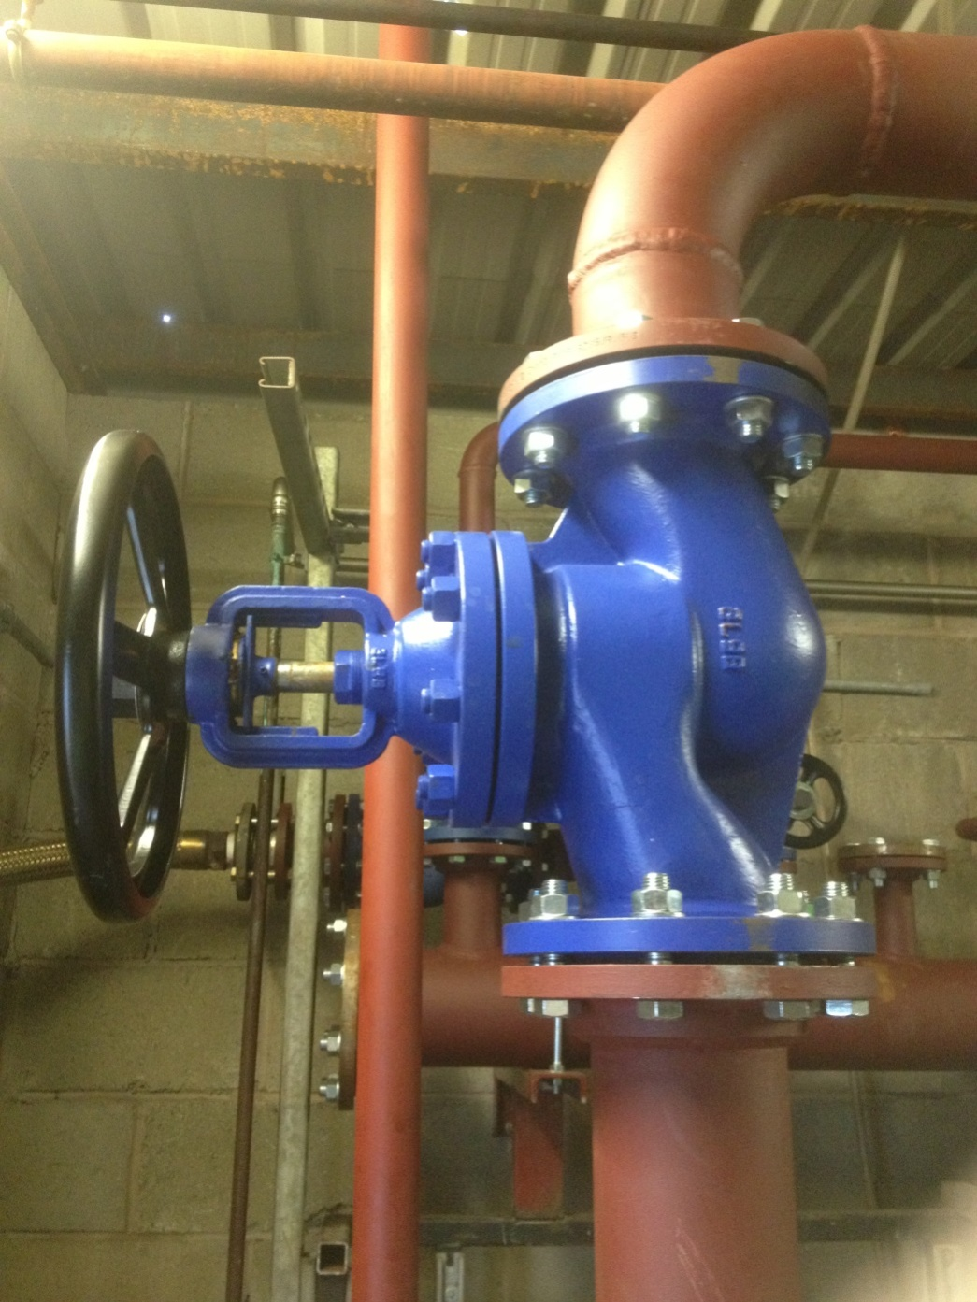
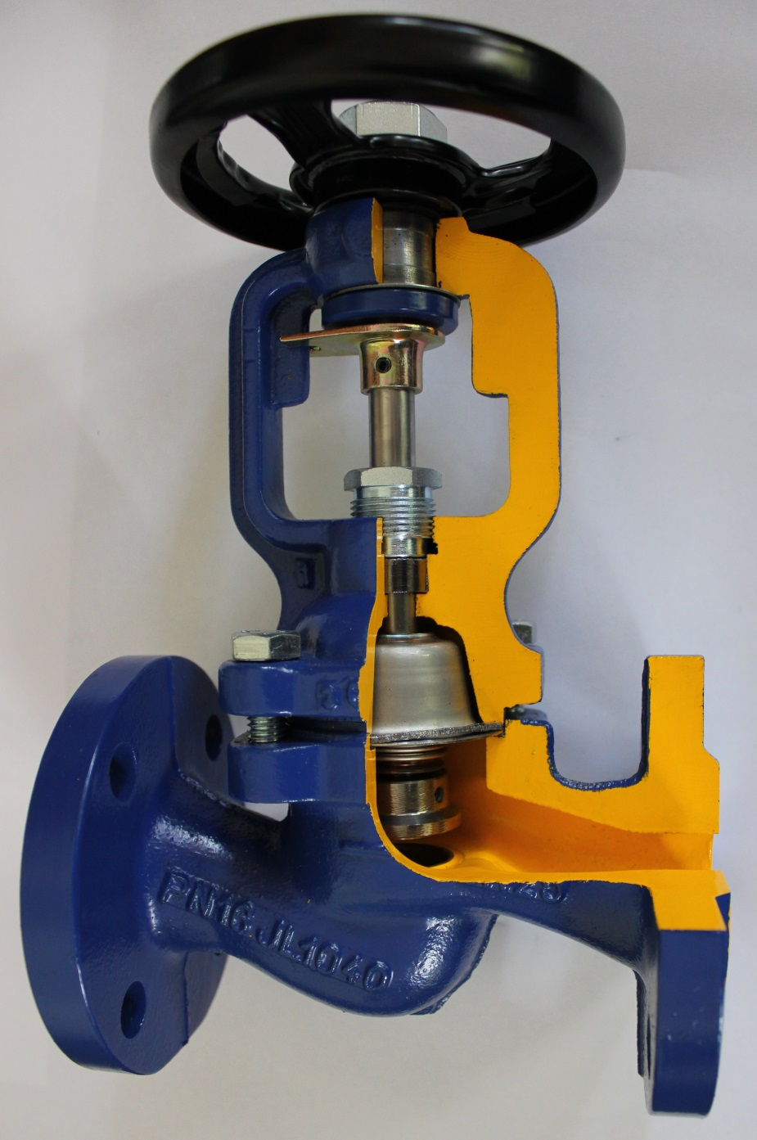
Steam Stop Valve

Slide 15
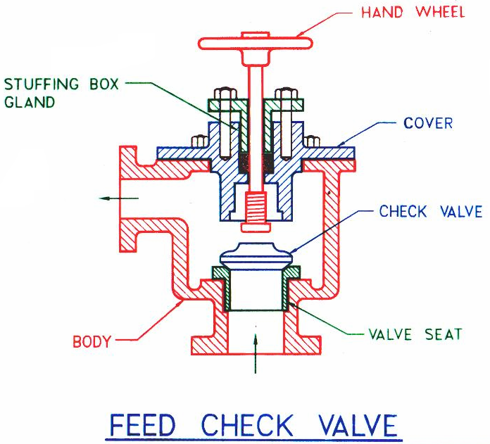
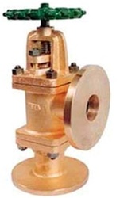
Construction:
The body of the valve is made of brass casting and except spindle, its every part is made of brass.
The spindle is made of muntz metal.
Function:
It is non return valve and used to regulate the supply of water,
which is pumped into the boiler, by the feed pump.
Location:
It is fitted to the shell slightly below the normal water level of the boiler.

Slide 16
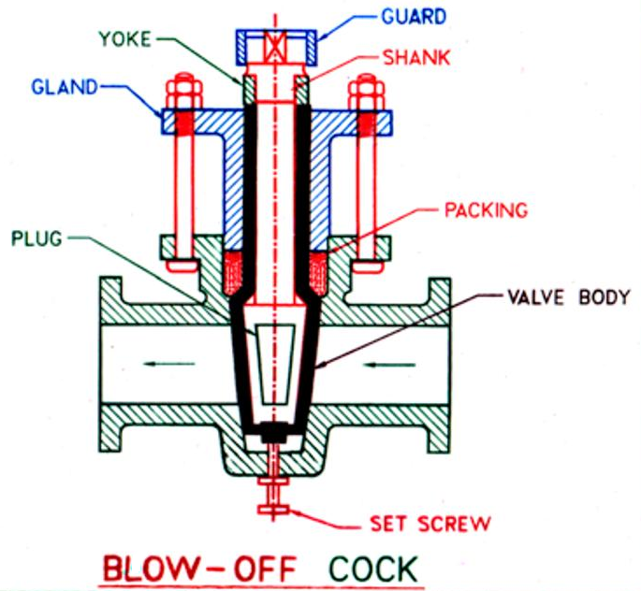
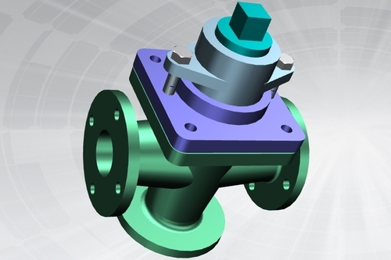
Construction:
The casing is packed with asbestos packing.
The sank of plug passes through the gland.
The plug is held down by yoke.
Function:
To empty the boiler whenever required and to discharge the
mud, scale or sediments which are accumulated at the bottom of the boiler.
Location:
It is fitted on the boiler shell directly at the lowest part of the water space.

Slide 17
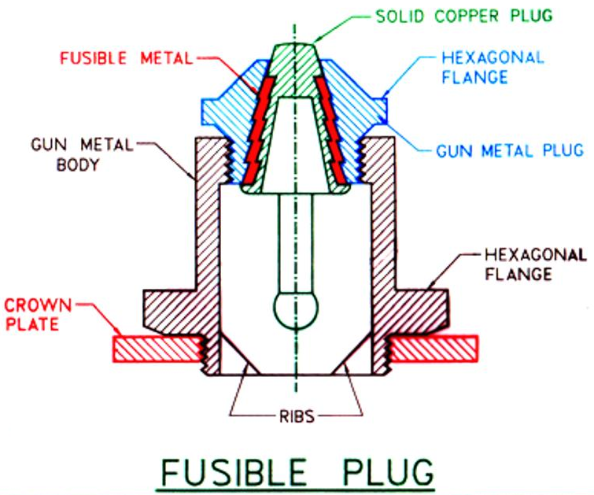
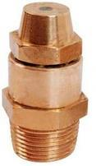
Construction:
It consists of hollow gun metal plug which is screwed in gun metal body.
The gun metal body is screwed to the crown plate.
The fusible metal is kept the gun metal plug.
Function:
To put off the fire in the furnace of the boiler when the level of water in the boiler falls to an unsafe limit, and thus avoids the explosion which may take place due to overheating of the furnace plate.
Location:
It is fitted in the crown plate of the furnace or fire box at appropriate place.

Slide 18
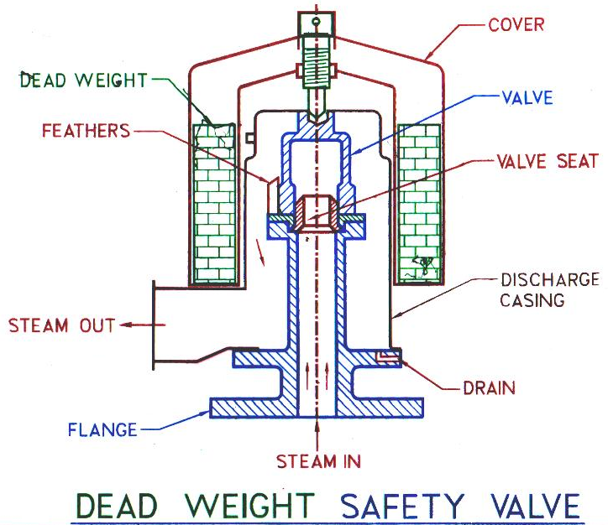
Construction:
The valve is made of gun metal and rests on its gun metal seat.
Advantage:
Simple in design
Give quite and satisfactory operation
Pressure adjustment is easy
Disadvantage
Unsuitable for boiler subjected to vibration and movement (locomotive boiler)
Not suitable for high pressure boiler
Function:
When steam pressure is increased beyond the limit pressure of the boiler, It opens automatically and some steam is discharged until the pressure inside the boiler is within the limit and thus it prevents the steam pressure inside the boiler to exceed.
Location:
It is directly fitted on the steam space of the boiler shell.

Slide 19
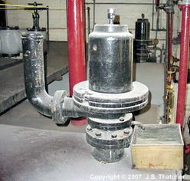
Dead weight safety valve

Slide 20
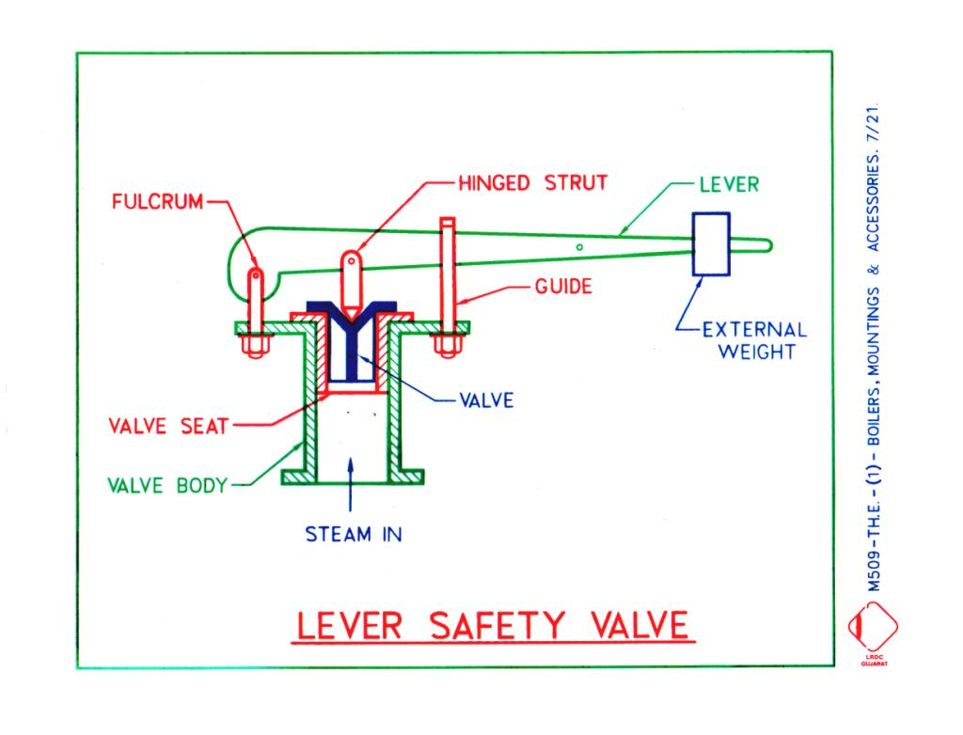
Construction:
It consists of a valve body with a flange fixed to the steam boiler.
The bronze valve seat is screwed to the body and the valve is also made of bronze.
Advantage:
It is very suitable valve for stationary boiler.
Disadvantage
The effect of small addition of the weight is magnified considerably in its action on the valve.

Slide 21
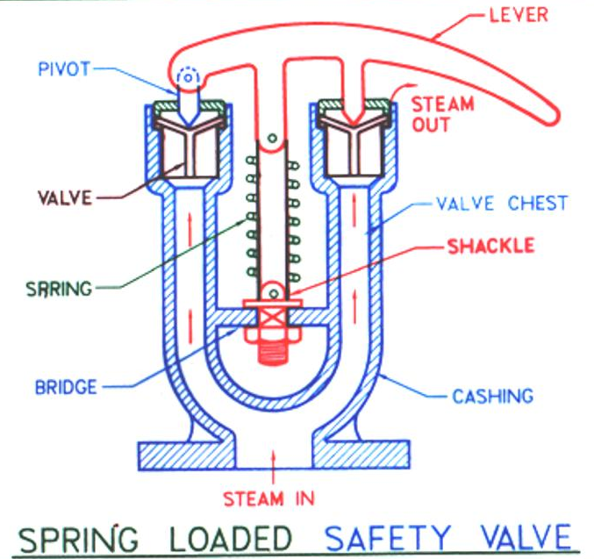
Construction:
It consists of a cast iron body connected to the top of a boiler.
It is loaded with spring made of round or square spring steel rod in helical form.
It may be in tension or compression, as the steam pressure acts along the axis of the spring.
In actual practice, the spring is placed in compression.
Advantage:
It is not affected by jerks and vibrations
Heavy weights are eliminated
Maintenance and examination is easy

Slide 22
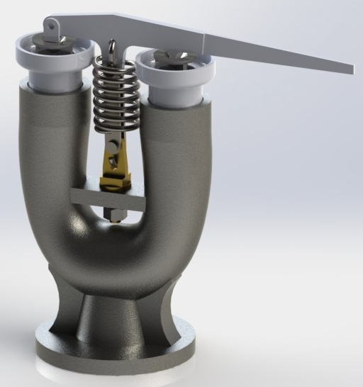
Spring Loaded Safety Valve

Slide 23
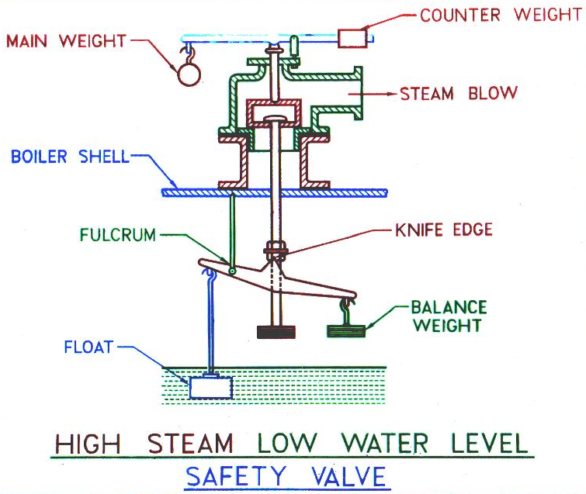
Construction:
It is a combination of two valves, one of which is the lever safety valve which blows off steam when the working pressure of steam exceeds.
The second valve operates by blowing off the steam when the water level becomes too low.
Advantage:
This is the best suited for top of Cornish and Lancashire boilers only.

Slide 24
Super heated steam to the Turbine / Work place
C
H
I
M
N
E
Y
Wet Steam
Coal
Boiler
Super heater
Economizer
Air –
Preheater
Ash
FEED PUMP
Air
Water
Water
Air
Schematic Diagram of Boiler Plant

Slide 25
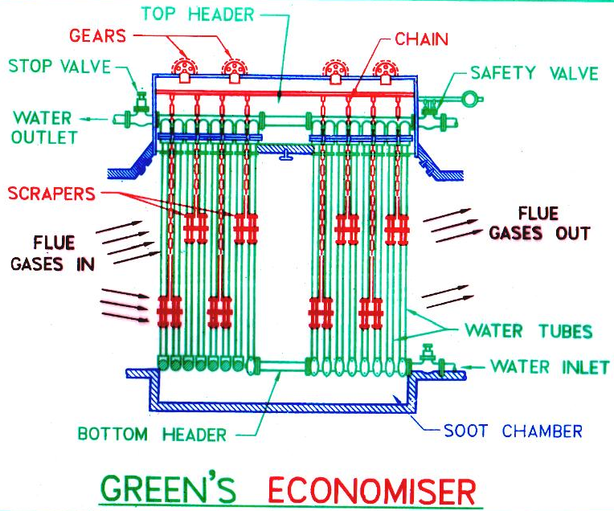
Construction:
It consists of a large number of vertical pipes of tubes placed in an enlargement of the flue gases between the boiler and chimney.
Tubes are 7.75 m long, 0.114m in dia. and 0.011m thick of C.I.
Advantage:
Fuel economy
Evaporative capacity of boiler increased
Increase in life of boiler due to less thermal stress
Increase in thermal efficiency
Disadvantage
Natural draft is insufficient and the plant must be provided with artificial draft
Capital cost is high
Not suitable for low pressure boiler
Function:
To heat feed water by utilizing the heat in the exhaust flue gases before leaving through the chimney. As the name indicates, the economizer improves the economy of the steam boiler.
Location:
After super heater and before air preheater as well as after feed pump and before boiler.

Slide 26
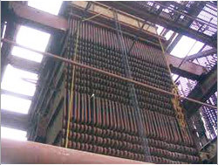
Economiser

Slide 27
Construction:
It consists of tubes which separated by baffles in the chamber.
Hot gas passes through the tubes while air is passes through the outside of the tubes.
Advantage:
Preheated air gives higher furnace temperature increases evaporative capacity per kg of fuel.
Boiler efficiency increases by 2%.
Results in better combustion with less soot, smoke and ash.
Low grade fuel can be used with less excess air.
Function:
The temperature of air required for the purpose of combustion is increased.
Location:
It is installed between economizer and chimney.

Slide 28
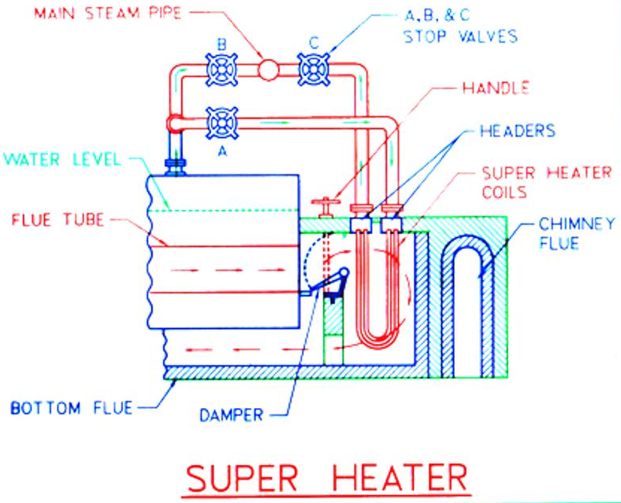
Construction:
It consists of two mild steel boxes or heaters from which hangs a group of solid drawn tubes bent to U-form. The ends of these tubes are expanded into the headers.
Function:
It is used to increase the temperature of steam and steam becomes super heated.
Location:
It is generally an integral part of a boiler, and is placed in the path of hot flue gases from the furnace.

Slide 29
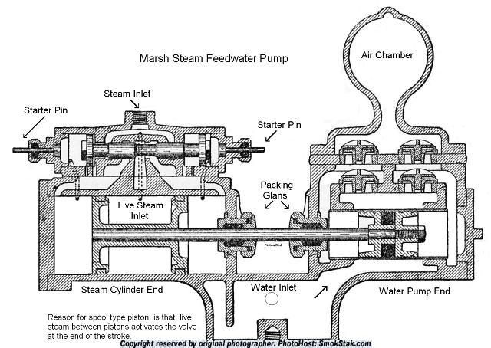
Function:
It is used to increase the pressure of feed water before it is made to enter the boiler.
Location:
Before the boiler.

