Slide 1
Unit 1 Energy Scenario
Asst.Prof. Krunal Khiraiya
Mechanical engineering department
Parul institute of engineering and technology

Slide 2
Energy conservation ACT 2001
•Enacted on 1st October 2001.
•Become effective from 1st March
2002.
•Objective of providing necessary
legal framework for promoting
energy conservation measures in
the country.
•Bureau of Energy Efficiency(BEE)
operationalized from 1st March2002.

Slide 3
PURPOSE OF THE EC-ACT 2001
• The purpose of this act is to provide for efficient use of energy and its conservation.
• Provide a policy framework and direction to national energy conservation activities.
• Coordinate policies and programs on efficient use of energy with stakeholders.
• Establish systems and procedures to verify measure and monitor EE improvements.
• Leverage multilateral, bilateral and private sector support to implement the EC Act.
• Demonstrate EE delivery systems through public-private partnerships.
• TO PROMOTE ENERGY EFFICIENCY IN THE COUNTRY .

Slide 4
Important Features Of Energy Conservation Act-2001
•Energy Conservation Building Code (ECBC)
•Standards & Labeling (S & L)
•Demand Side Management (DSM)
•Bachat Lamp Yojana (BLY).
•Promoting Energy Efficiency in Small & Medium Enterprise (SMEs).
•Designated Consumers .
•Certification of Energy Managers & Energy Auditors.

Slide 5
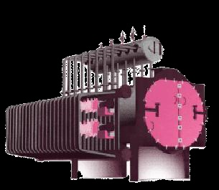
1. STANDARDS & LABELING
Evolve minimum energy consumption and performance standards for notified equipment & appliances.
Prohibit manufacture and sale
Of equipment & appliances
not conforming to standards.
Introduce mandatory labeling
to Enable consumers to make
informed choice.

Slide 6
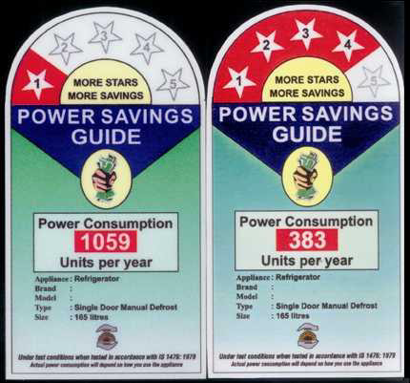

Slide 7
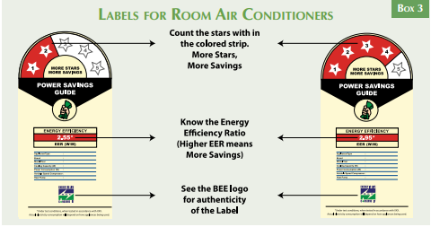

Slide 8
2. DESIGNATED CONSUMER
Designated Consumers to :
•Get energy audit by Accredited energy audit firms and energy audit conducted by an accredited energy auditor.
•Implement cost effective recommendations
•Appoint or designate energy manager
•Comply with energy consumption norms
By regulations BEE to prescribe:
•Qualification and certification procedure for Energy Manager & Energy Auditors.
•Accreditation procedure for Energy Audit firms.

Slide 9
3. Energy Conservation Building Codes
BEE to prepare guidelines on ECBC .
To provide minimum requirements for the energy efficient design and construction of buildings.
Mandatory for commercial buildings having connected load of >=500KW or contract demand of >=600 KVA. Also applicable for air-conditioned area of >=1000 sq.mt. Including existing bldgs .

Slide 10
4. ENERGY COSERVATION FUND
To set up Energy Conservation Fund for providing :
Promotion of Energy Service Companies.
Research & Development
Demonstration.
Creation of testing facilities
Awareness Creation.

Slide 11
5. Bureau Of Energy Efficiency
Important Roles include:
Implementation of provisions of
Energy Conservation Act.
Quick coordination.
Policy research.
Promotion of Energy Efficiency.
Development of new financial
instruments.
Development of ESCOs.
The primary objective would be to
reduce energy intensity in Indian
Economy.
Awareness Creation.

Slide 12
6. Role Of BUREAU OF ENERGY EFFICIENCY
The Role of BEE WOULD be to prepare standards and labels of appliances and equipment, develop a list of designated consumer, specify certification and accreditation procedure, preparing building codes, maintain central EC fund, and undertake promotional activities in co-ordination with central and state level agency.
The role would include development of ESCOs. Transforming the market for energy efficiency and create awareness through measure including clearing house.

Slide 13
7. Role of central and state government
CENTRAL – to notify rules and regulation under various provisions of the ACT , provide initial financial assistance to BEE and EC fund , Coordinate with various State Government for notification ,penalties and adjudication.
STATE – to amend energy conservation building codes to suit the regional and local climatic condition, to designete state level agency to coordinate , regulate and enforce provisions of the ACT and constitute a state Energy Conservation Fund for promotion of energy efficiency.

Slide 14
8. Bachat lamp yojna
(CDM Based Lighting Project for House hold)
• First pilot project registered by UNFCCC in
September 2008 .
(National Roll out to be take place shortly)
• Targeted 400 Millions incandescent Lamps
and its replacement to CFLs at the price of
incandescent bulbs to avoid 4000 MW
Capacity Addition.
• The difference in cost would be recovered
through the carbon credits CERs that
accrue because of their lower energy use.

Slide 15
9. PENALTIES
Non-Compliance by a Person:
• Amount Not Exceeding Rs.10,00,000/-For Each Offence.
• On Continuous Non – Compliance An Additional
Penalty Up to Rs.10000/- Per Day.
The initial phase of 5 years would be promotional and
creating infrastructure for implementation of ACT. No penalties would be effective during this phase.

Slide 16
Sector wise Energy Consumption and Tips for energy conservation for Different Sector

Slide 17
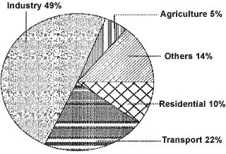
Sector Wise Energy Consumption in India
The major commercial energy consuming sectors in the country are classified as shown in the Figure.
As seen from the figure, industry remains the biggest consumer of commercial energy and its share in the overall consumption is 49%. (Reference year: 1999/2000)

Slide 18
Boilers
Preheat combustion air with waste heat.
Use variable speed drives on large boiler combustion air fans with variable flows.
Burn wastes if permitted.
Insulate exposed heated oil tanks.
Clean burners, nozzles, strainers etc.
Inspect oil heaters for proper oil temperature.
Close burner air and stack dampers when the burner is off to minimize heat loss up the stack.
Improve oxygen trim control
Use boiler blow down to help warm the back-up boiler.
Optimize deaerator venting.
Inspect door gaskets.
Optimize boiler water treatment.
Add an economizer to preheat boiler feed water using exhaust heat.
Recycle steam condensate.

Slide 19
Furnaces
Check against infiltration of air use doors or air curtains.
Monitor O/CO and control excess air to the optimum level.
Improve burner design, combustion control and instrumentation.
Ensure that the furnace combustion chamber is under slight position pressure.
Use ceramic fibers in the case of batch operation.
Match the load to the furnace capacity.
Retrofit with heat recovery device.
Investigate cycle times and reduce.
Provide temperature controllers.
Ensure that flame does not touch the stock.

Slide 20
Refrigeration
Use water cooled condensers rather than air-cooled condensers.
Challenge the need for refrigeration, particularly for old batch processes.
Avoid over sizing match the connected load
Use “free cooling” to allow chiller shutdown in cold weather
Use refrigerated water loads in series if possible
Convert firewater or other tanks to thermal storage
Make adjustments to minimize hot gas bypass operation
Inspect moisture indicators
Check for correct regrigerant charge level
Consider change of refrigerant type if it will improve efficiency
Inspect the purge for air and water leaks

Slide 21
Lighting
Select ballasts and lamps carefully with high power factor and long term efficiency in mind
Upgrade obsolete fluorescent systems to compact fluorescents and electronic ballasts
Consider day lighting ,skylights etc
Use task lighting and reduce background illumination
Change exit signs from incandescent to LED

Slide 22
Power Development in India

Slide 26
Development in Oil & Gas Energy Sector

Slide 27
Development in Coal Energy Sector

Slide 29
Development in Renewable Energy Sector

Slide 30
Development in Nuclear Energy Sector

Slide 31
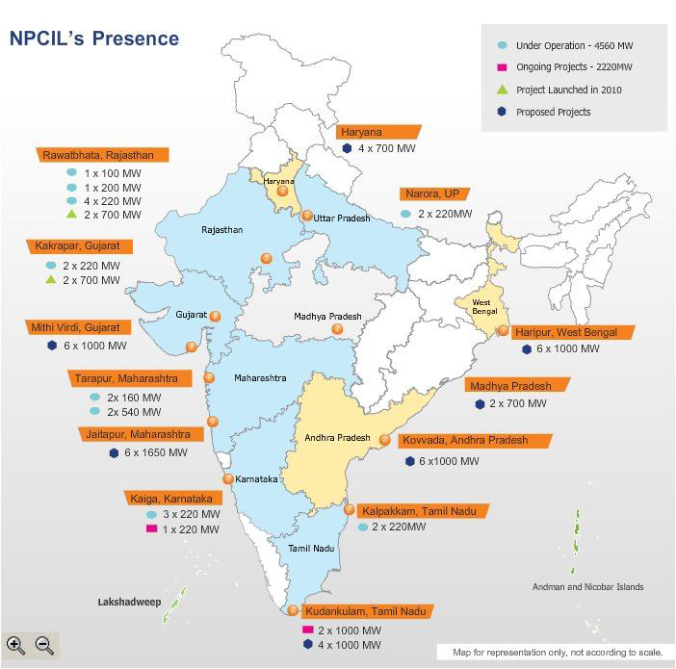

Slide 35
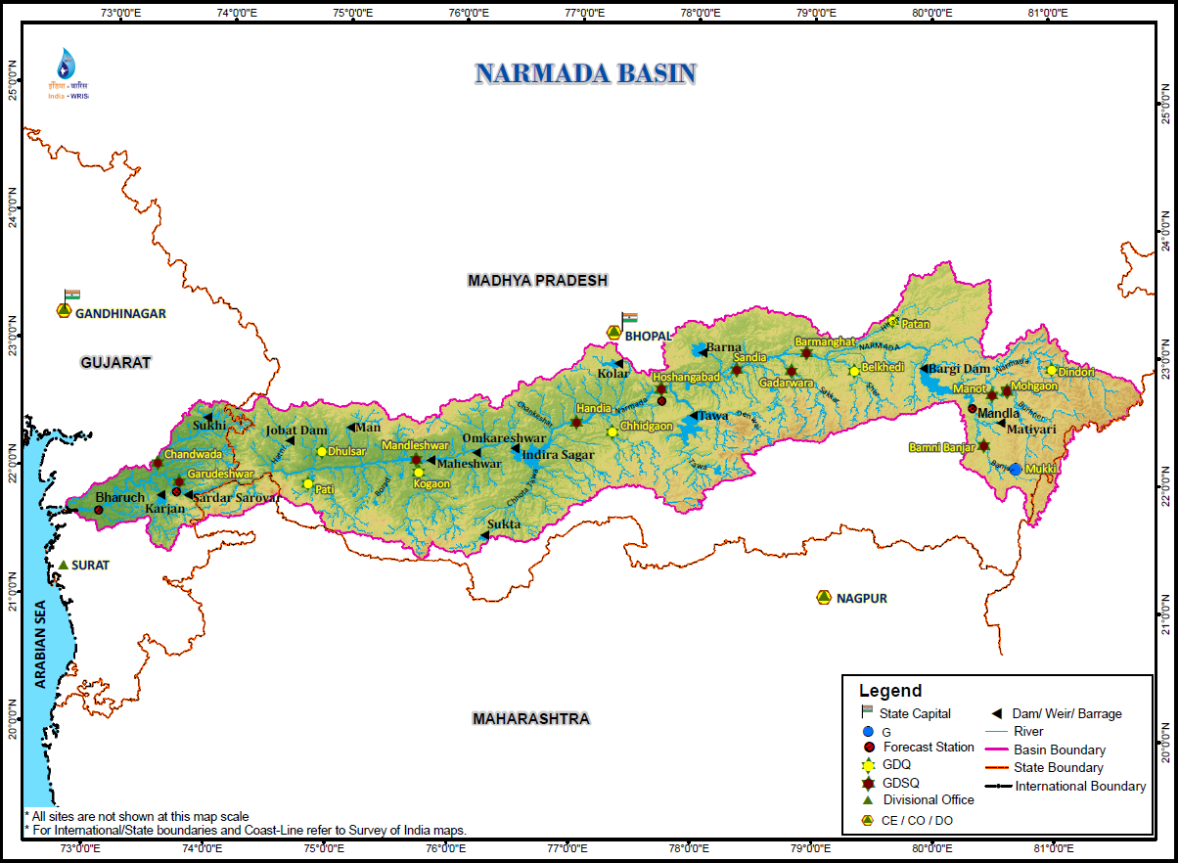

Slide 36
