Slide 1
Unit 4 properties of steam
Asst.Prof. Krunal Khiraiya
Mechanical engineering department
Gyanmanjari institute of technology

Slide 2
Objective
Able to know how to measure a dryness fraction
Able to know about construction and working of different types of steam calorimeter
Able to describe procedure for measurement of dryness fraction using different types of steam calorimeter
Calculate dryness fraction with the help of given data

Slide 3
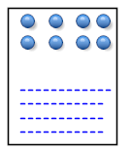
Dryness fraction
ms
mw
Wetness fraction

Slide 4
Importance of dryness fraction
Wet steam at a given pressure has specific temperature for the entire range of dryness fractions from 0 to 1. the pressure and temperature of wet steam are not the sufficient thermodynamic properties to specify the state of steam. It needs two independent properties such as temperature of pressure and dryness fraction to indentify the state of steam
T
H

Slide 5
How to measure (dryness fraction)
Wet steam contains water particles in suspension form with the dry steam and the amount of these water particles needs to be estimated to find out the dryness fraction of wet steam
The dryness fraction of steam can be determined with the help of steam calorimeter.
There are four types of steam calorimeter for determining the dryness fraction of steam.
bucket or barrel calorimeter
Throttling calorimeter
Separating calorimeter
Combined separating and throttling calorimeter

Slide 6
BUCKET OR BARREL CALORIMETER.

Slide 7
BUCKET OR BARREL CALORIMETER.

Slide 8
CALCULATION OF DRYNESS FRACTOIN OF STEAM
P= PRESSURE OF STEAM, BAR
H_{F1} = ENTHALPY OF LIQUID AT P BAR PRESSURE KJ/KG
H_{F2} = ENTHALPY OF WATER AFTER MIXING AT T₂ KJ/KG
T₁ &T₂ = TEMP. OF WATER & VESSEL BEFORE & AFTER EXP RESP., KJ/KG
H_{FG1} = ENTHALPY OF EVAPORATION OF STEAM, KJ/KG
M_{S} & M _{W} =MASS OF STEAM CONDENSED & CALORIMETER, KG
M _{CAL} = MASS OF CALORIMETER , KG
C _{PW} & C _{PC}= SPECIFIC HEAT OF WATER & CALORIMETER ,KJ/KG K
X = DRYNESS FRACTION OF STEAM.

Slide 9
HEAT LOST BY STEAM = HEAT GAINED BY WATER & CALORIMETER.
M_{S} (H_{F1} + XH_{FG1} – H_{F2} )= M_{CAL} C _{PC} (T₁ -T₂ ) +M_{W} C _{PW} (T₁ -T₂ )
= (M_{CAL} × C_{PC} / C_{PW} +M_{W} ) C_{PW} (T₁-T₂)
THE TERM (M_{CAL} × C_{PC} / C_{PW} ) IS CALLED WATER EQUIVALENT OF CALORIMETER.
LIMITATIONS :
THIS METHOD IS NOT ACCURATE.
ACCURACY INCREASE AS TEMPERATURE DIFFERENCE INCREASE BECAUSE LOSSES ARE MORE AT HIGHER TEMPERATURE DIFFERENCE.

Slide 10
THROTTLING CALORIMETER

Slide 12
THROTTLING CALORIMETER

Slide 13
p₁ & p₂ = pressure of steam before and after throttling x= dryness fraction of steam h _{f g} = enthalpy of evaporation at p₁ ,kj/kg h _{g2} = enthalpy of saturated steam at p₂ ,kj/kg h_{w} = height of manometer ,mm of water c_{ps} = specific heat of superheated steam, kj/kgk t _{sat} =saturated temp. at p₂ ,⁰c t _{sup} = temp. measure after throttling ,⁰c h_{f1} & h_{f2}= enthalpy of water before & after throttling resp., kj/kg
CALCULATION OF DRYNESS FRACTION:

Slide 14
enthalpy before throttling (p₁) =enthalpy after throttling(p₂) h_{f1} + xh_{fg1} = h_{f2} +h_{fg2} + c_{ps} (t₁ -t₂ ) h_{f1} + xh_{fg1} = h_{g2} + c_{ps} (t₁ -t₂ ) X = h_{g2} + c_{ps} (t₁ -t₂ )- h_{f1} / h_{fg1} LIMITATIONS: It is suitable for measurement of higher value of dryness fraction. After throttling steam must be at least dry saturated.

Slide 15
SEPERATING CALORIMETER

Slide 16
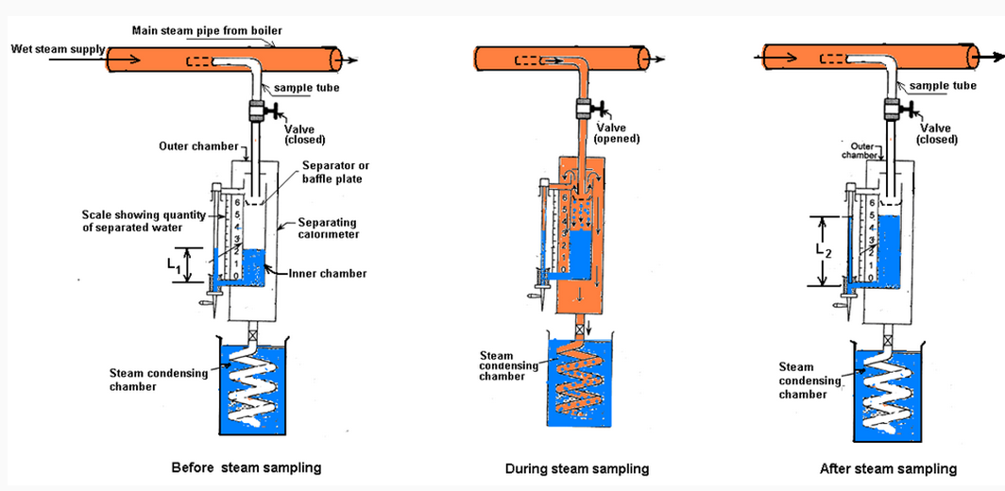
SEPERATING CALORIMETER

Slide 17
CALCULATION: m_{s} = mass of steam in barrel calorimeter , kg m_{w} = mass of water collected in inner chamber , kg X =dryness fraction = m_{s} /m_{s} + m_{w.} LIMITATION: only approx value of dryness fraction.

Slide 18
COMBINED SEPARATING &COMBINING CALORIMETER

Slide 19
COMBINED SEPARATING &COMBINING CALORIMETER

Slide 20
CALCULATION :
X₁ = DRYNESS FRACTION MEASURE BY SEPARATING CALORIMETER.
X₁ = M_{S} /M_{S} + M_{W}
WHERE M_{S} = MASS OF STEAM PASSING TO THROTTLING CALORIMETER FROM SEPARATING CALORIMETER
M_{W} = MASS OF WATER COLLECTED IN SEPARATING CALORIMETER, KG
X₂ = DRYNESS FRACTION OF WET STEAM WHICH ENTER INTO THE THROTTLING CALORIMETER.
X₂ = H_{G2} + C_{PS} (T₁ -T₂ )- H_{F1} / H_{FG1}

Slide 21
IF X IS INITIAL DRYNESS FRACTION OF STEAM
THEREFORE WATER DROPLET IN STEAM SAMPLE = (1-X)(M_{S} +M _{W} ) KG
THEREFORE WATER DROPLET REMOVED BY SEPARATING CALORIMETER= (1-X₁)(M_{S} +M _{W} ) KG
Therefore water droplet passed by throttling calorimeter = (1-x2)(ms ) kg
Therefore water droplet in steam sample = water droplet removed by separating calorimeter + water droplet passed by throttling calorimeter.
Therefore (1-x)(ms +mw)=(1-x1)(ms +mw) + (1-x2)(ms )
(1-x)= (1-x1)+ (1-x2)(ms )/ (ms +m w ) .
Since x1 = ms /ms + mw.
1-x = 1+x1-x1 -x1x2
x = x1x2.

Slide 22
V-lab

Slide 23
Calculation with the help of labview and scilab

Slide 24
Experiment video

Slide 25
simulator

Slide 26
THANK YOU
QUESTION???

